Slide 1


WOLTERS KLUWER
Infrastructure Operations Analysis

Slide 2
PROJECT OVERVIEW
Wolters Kluwer, a global leader providing expert solutions for clients including Healthcare, Legal, Regulatory, Environmental, and Governance (ESG), is seeking to optimize its data management and reporting processes
This project consists of analysis of Wolters Kluwer's existing cloud accounts, address data quality, classification, log file analysis and the development of Power BI dashboards
Notes:
Project Overview

Slide 3
Objective
Data Quality Enhancement
Data Classification Analysis
Log File Analysis
Power Bi Dashboards

Slide 4

PROBLEM STATEMENT (Phase 1 : Data Quality Test)
Cloud Management Accounts have incorrect or missing data (metadata) in ITSM​
The data is not consistent throughout the fields
Cloud Management Accounts are required to have mandatory attributes assigned in the ITSM​
Current Automation (pipeline/script) collects, validates and applies all the required values, older (existing/legacy) accounts do not have the same content populated or the existing values are not “valid”​
Notes:
WHo WHAT WHY

Slide 5
PROBLEM STATEMENT (Phase 2 : Log File Analysis)
Cloud account activity logs show all the relevant activity
Analyze cloud account activity for limited resource types
AWS Resource Types - EC2 – RDS – DynamoDB – Load Balancers – EFS – Kms – Transit gateway
Azure Resource Types - VM – SQL Database – Load Balancers – Availability Sets – CosmosDB – Application Gateway – Key Vault – Virtual Network Gateway – Express Route – SQL Server – AzureDB – MariaDB – Transit Gateway
Determine, the source of the action based on user/SPN/automation, script
Notes:
WHo WHAT WHY

Slide 6

PHASE 1
Completeness and Validity Scores for Cloud accounts.

Slide 7
Data Quality Tests for Cloud accounts
COMPLETNESS
VALIDITY
Conducted Analysis for Active Cloud Accounts.
Checked Completeness for 12 Mandatory Tags based on standards set by Wolters Kluwer.
Provided a scoring for each mandatory tag.
Checked the validness of the Mandatory Tags in respect to the standards and rules provided.
Used DAX and M code queries for calculation.
Provided a validity scoring for the tags.
DATA QUALITY
Calculated data quality for cloud accounts using completeness and validness scoring.

Slide 8
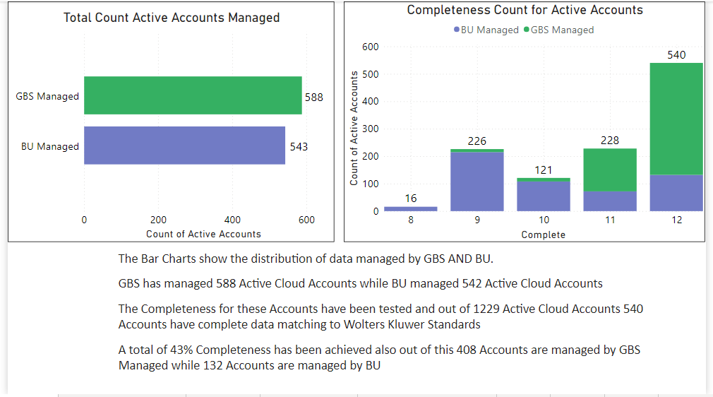

Slide 9
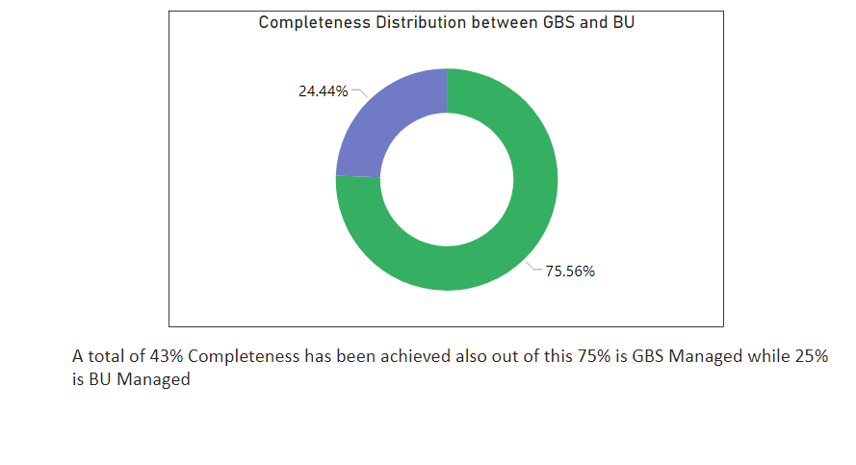
Wolters Kluwer - Company Confidential Materials - Do not share

Slide 10
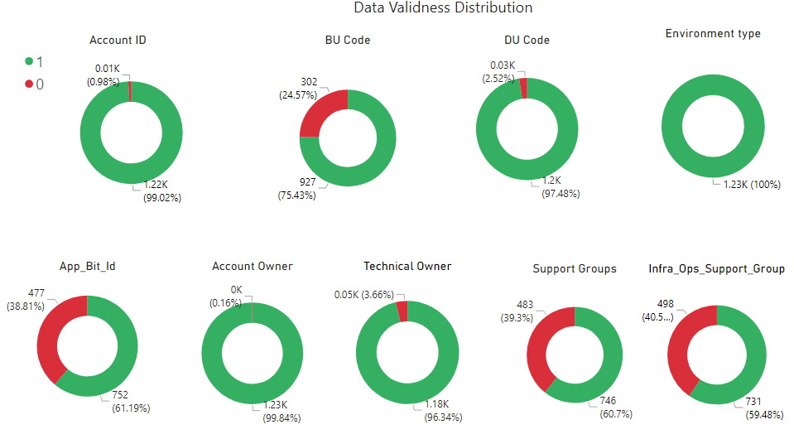

Slide 11
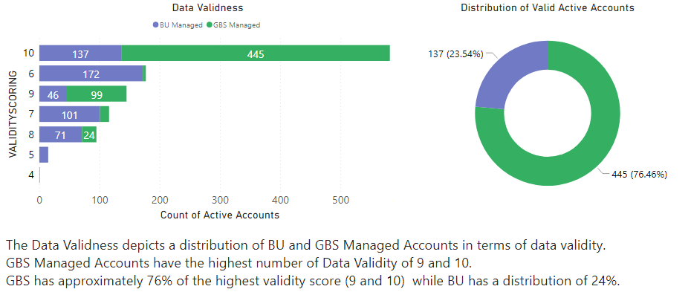
Data Validity

Slide 12
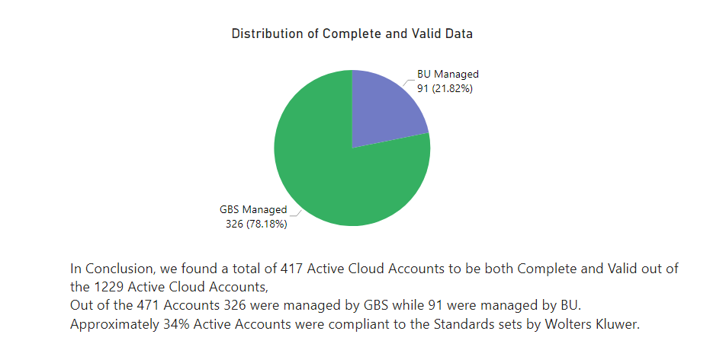
Conclusion

Slide 13
PHASE 2
Log File Analysis AWS & Azure

Slide 14

LOG FILE ANALYSIS AWS
Analyzed the AWS Log Files related to the Cloud Accounts
Identified the various Resource Types within the cloud accounts
Identified Common Actions and differentiated those actions into (User/Automated) within those Resource types.

Slide 15
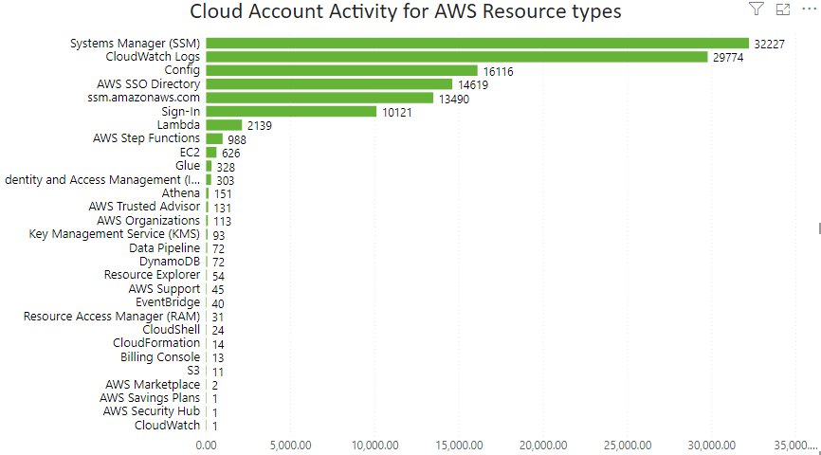
AWS Resource Distribution
AWS Resource types used in Cloud Accounts.
Some of the most frequently used resource types are Systems Manager, Cloud Logs, Config, Directory.
SSM contributes to 26% of total resource types while Cloud logs is 24% of the total resource types.
Wolters Kluwer - Company Confidential Materials - Do not share

Slide 16
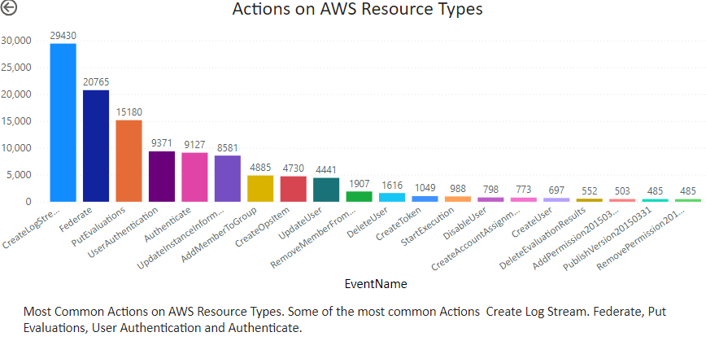
Common Actions on AWS
Wolters Kluwer - Company Confidential Materials - Do not share

Slide 17
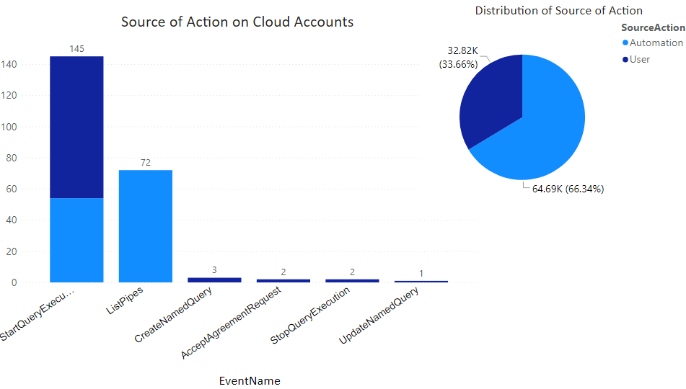
Common Actions on AWS
The first visuals shows us the common actions on filtered AWS Resource types ( Athena, Marketplace and Data Pipeline )
The pie chart depicts the distribution of common actions between User and Automated.
Approx 65% actions on Resources are automated while 32% are done manually.
Wolters Kluwer - Company Confidential Materials - Do not share

Slide 18
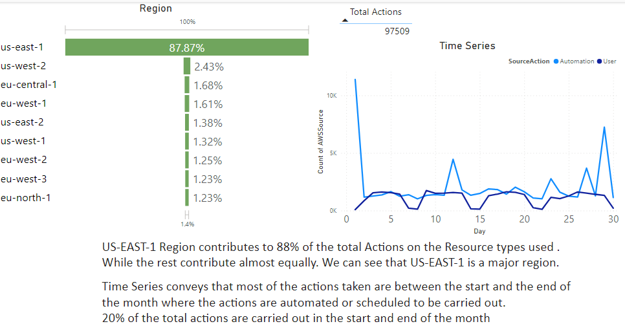
Wolters Kluwer - Company Confidential Materials - Do not share

Slide 19

LOG FILE ANALYSIS AZURE
Analyzed the Azure Log Files related to the Cloud Accounts
Identified the various Resource Types within the cloud accounts
Identified Common Actions and differentiated those actions into (User/Automated) within those Resource types.

Slide 20
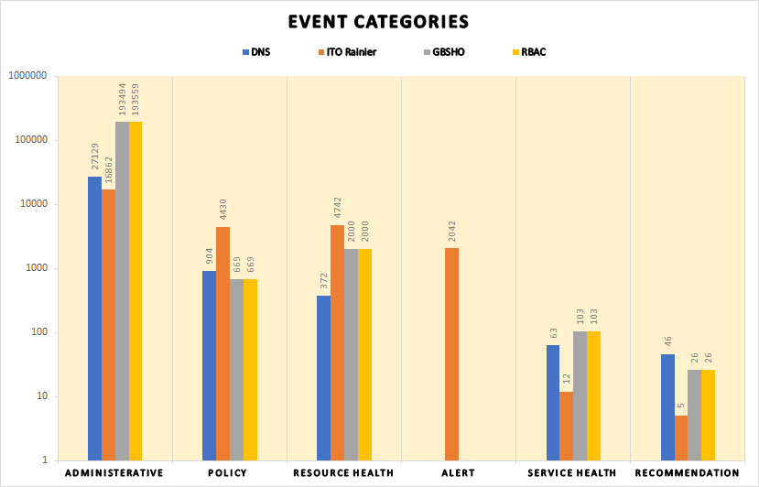
Event Categories Distribution
Insights :
Administrative events are prevalent across all systems, indicating various administrative activities or changes.
ITO Rainier stands out with a significant number of alerts, suggesting potential issues that need attention.
Resource health events are notable in DNS, ITO Rainier, GBSHO, and RBAC.
Service health events are recorded for DNS, GBSHO, and RBAC, with the highest count in GBSHO.
Policies are more actively managed in ITO Rainier compared to other systems.
Wolters Kluwer - Company Confidential Materials - Do not share

Slide 21
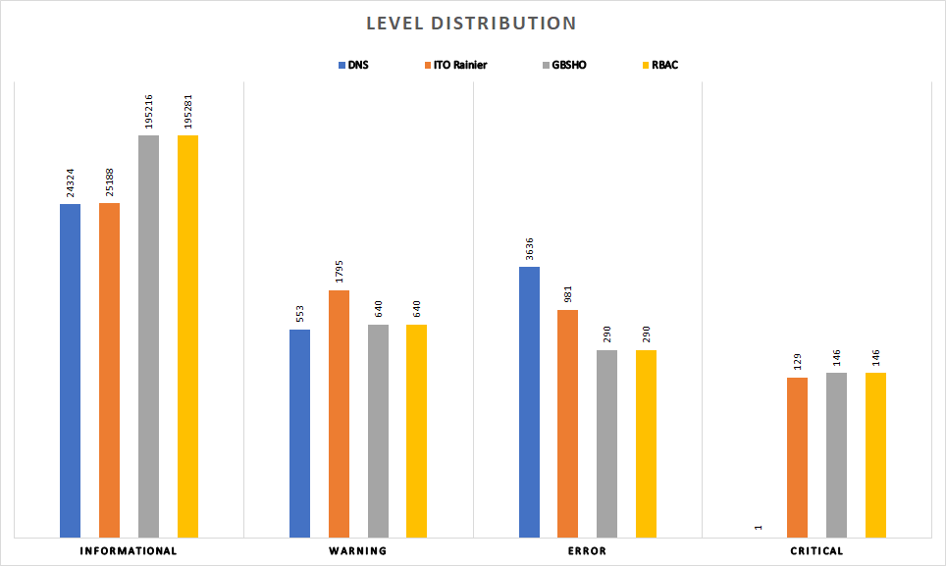
Level Distribution
Insights :
All systems have a notable number of informational events, suggesting routine or non-critical activities.
The number of critical events is generally low across all systems, except for ITO Rainier.
ITO Rainier has the high count of critical events, indicating potential issues that require attention.
GBSHO and RBAC show similar patterns in terms of event distribution.
Wolters Kluwer - Company Confidential Materials - Do not share

Slide 22
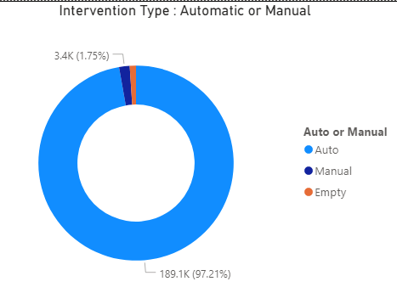
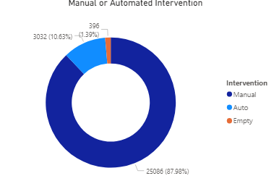
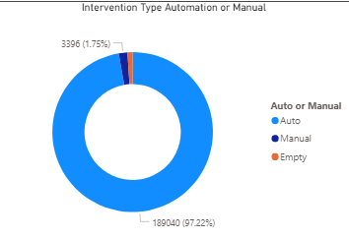
Event Initiation : Auto or Manual
RBAC
DNS
GBSHO
When analyzing if event was initiated manually or by automation, we observed for DNS around 88% of events were initiated Manually out of which around 71.25% were initiated by 1 person. This needs to be analyzed and automated if possible.
Small number of events (around 1%) which can be as Empty were Health Events Activated, probably by the provider hence there is no value for event initiated by column
Wolters Kluwer - Company Confidential Materials - Do not share

Slide 23
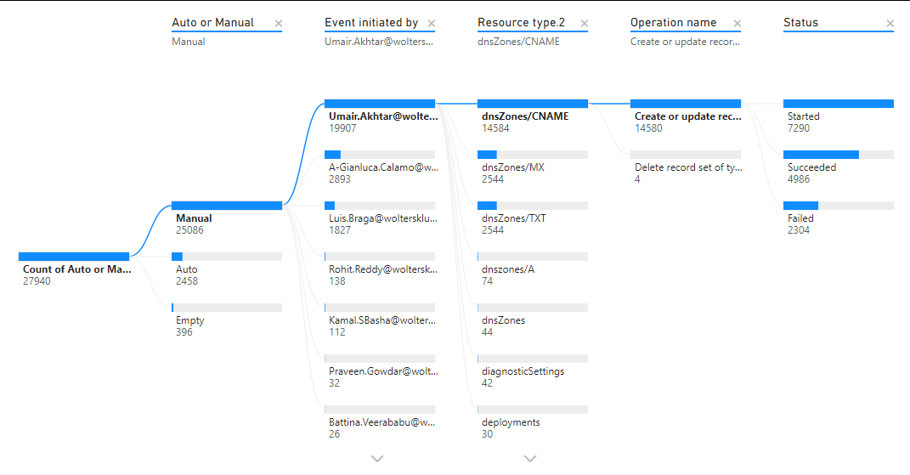
Decomposition Tree for Holistic Overview on Azure Data
Insights: Here we observe that dnsZones/CNAME resource type initiated manually for setting up aliases and redirecting traffic from one domain to another has high failure count for create/ update operation even though they were initiated manually.
This tree gives us good overview to take actions on the failed events, determining the scope for automating the manual tasks and inquiring on logging enabled for health-related events.
Snapshot based on DNZ Data. Focusing on high count of events initiated by manual user
Wolters Kluwer - Company Confidential Materials - Do not share

Slide 24
Assumptions
Phase 1
We have considered only Active accounts for validity and completeness check.
Phase 2
We have taken cutoff as 200 to show the number of operations performed for Azure.
Not all resource types were found in the logs.

Slide 25

Suggestions and Future Scope
Can be integrated with folder on a drive. Will become a plug and play feature. User will need to put the latest cloud account details or log file for visualizations to refresh.
Date trends and cost insights could be added if the data is provided which can be used for tracking budgets.
Potential for automation of manual operations performed on Azure and AWS.

Slide 26


THANK YOU!!

